Slide 1
Computer Vision (911.908, WS 20/21)
Roland Kwitt
Department of Computer Science
University of Salzburg, Austria

Slide 2
Schedule for today
Logistics
Resources
What is computer vision?
Some typical computer vision problems

Slide 3
Logistics
E-Mail: Roland [dot] Kwitt [at] sbg [dot] ac [dot] at
Course material: available online at http://rkwitt.org (→ Teaching)

Slide 4
Logistics
Grading
1 final exam at the end of the course.

Slide 5
Resources
PyTorch
https://pytorch.org/
scikit-learn (Python)
http://scikit-learn.org/stable/
scikit-image (Python)
http://scikit-image.org

Slide 6
Resources
“Deep Learning”
Goodfellow, Bengio, Courville
http://www.deeplearningbook.org/
Please check the course website for updates on relevant research papers.

Slide 7
Resources
We will mostly be talking about “recent” approaches to computer vision, using (deep) neural networks.
However, I still do want to mention a “classic” vision book which is definitely worth reading.
“Computer Vision: Algorithms and Applications”
R., Szeliski, 2010
http://szeliski.org/Book/

Slide 8
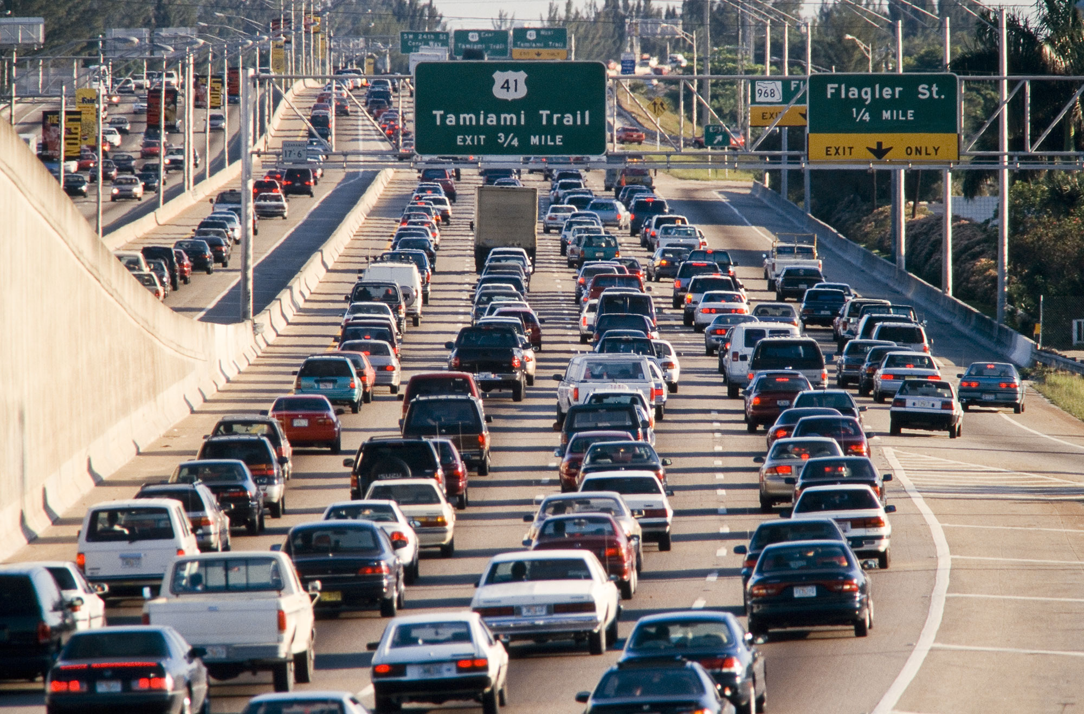
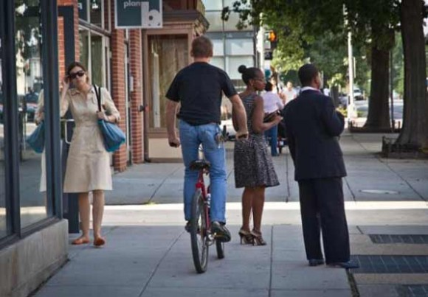
What is computer vision?
Courtesy of Szeliski
(Luiz Gomez Photos)
The human visual system (HVS) is remarkably good at so many tasks, e.g.,
- detecting people & object’s
- perceiving translucency, shape, color (see figure on the left),
- counting people & vehicles (see middle figure)
- recognizing scenes, etc.

Slide 9
What is computer vision?
Remarkable fact:
A substantial fraction of the macaque’s total cortical area is devoted to vision (approx. 15% according to [Hubel, “Eye, Brain and Vision”] )

Slide 10
What is computer vision?
We want to build systems for automatic understanding of images/videos.
This includes, but is not limited to,
1) inferring properties of the 3D world (measurement)
2) enabling recognition of objects, people, scenes, etc. (perception)
3) mining, searching and interacting with visual data (search / organization)
Slide adapted from Kristen Grauman, “Introduction to Computer Vision”

Slide 11
What is computer vision?
Graphics
Image Processing
Artificial Intelligence
Computer Vision
Machine Learning
Cognitive Science
Slide adapted from Kristen Grauman, “Introduction to Computer Vision”

Slide 12
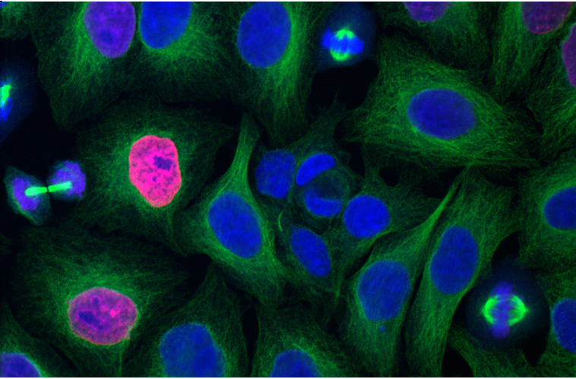
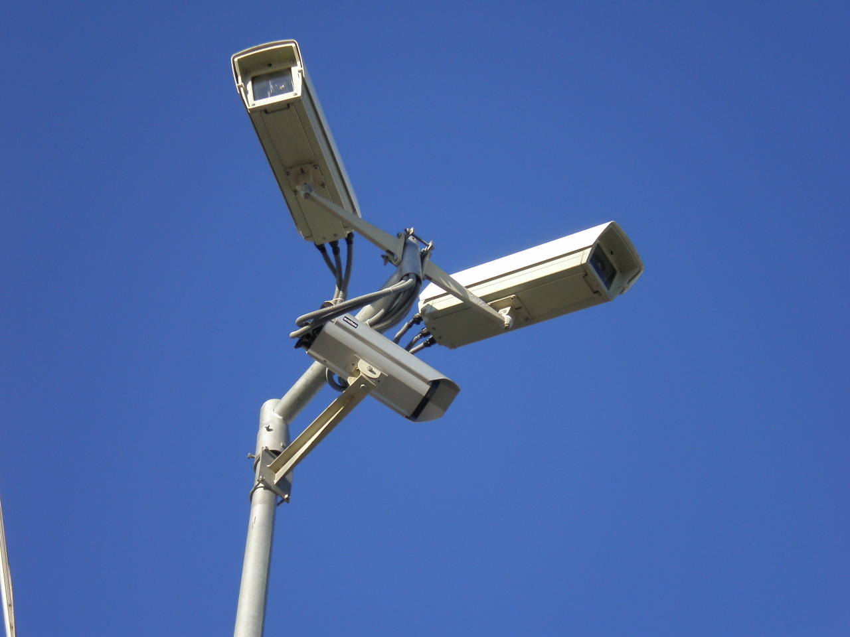
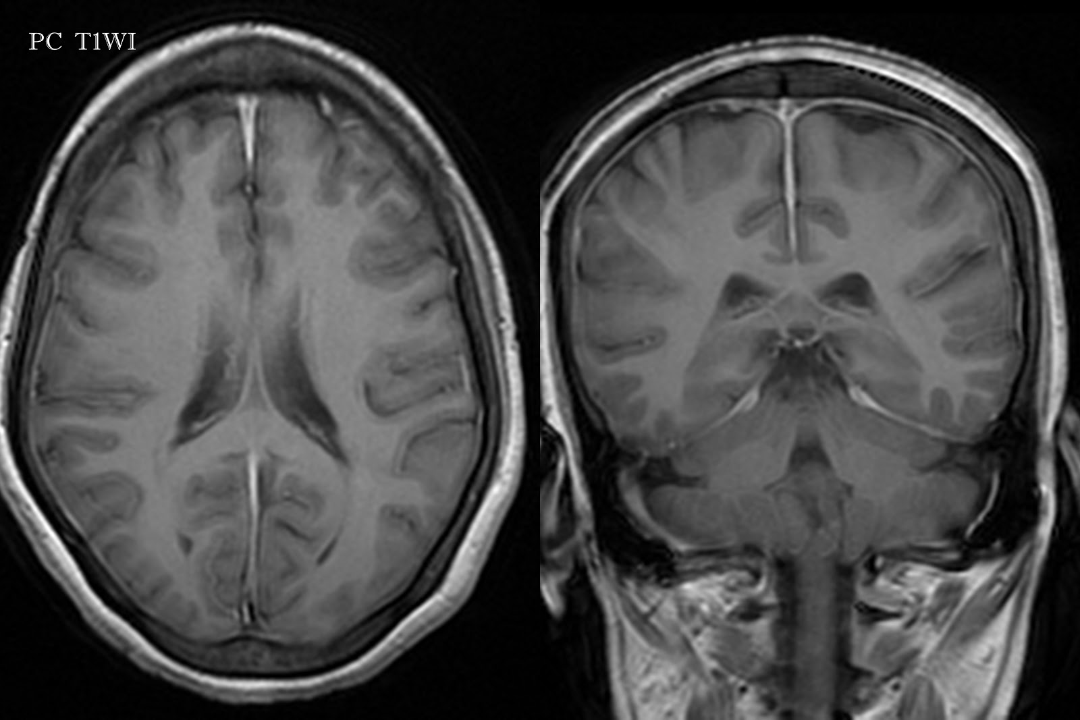
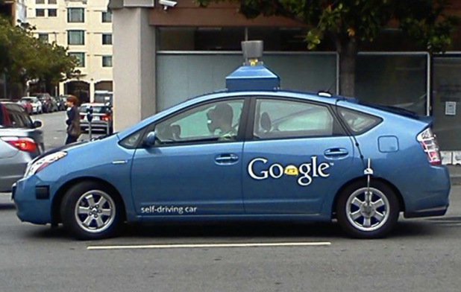
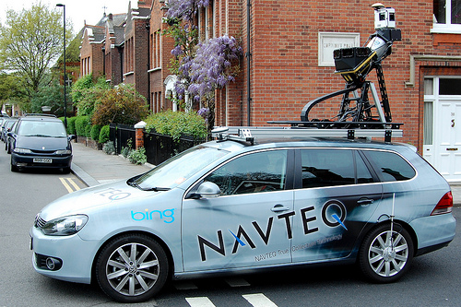
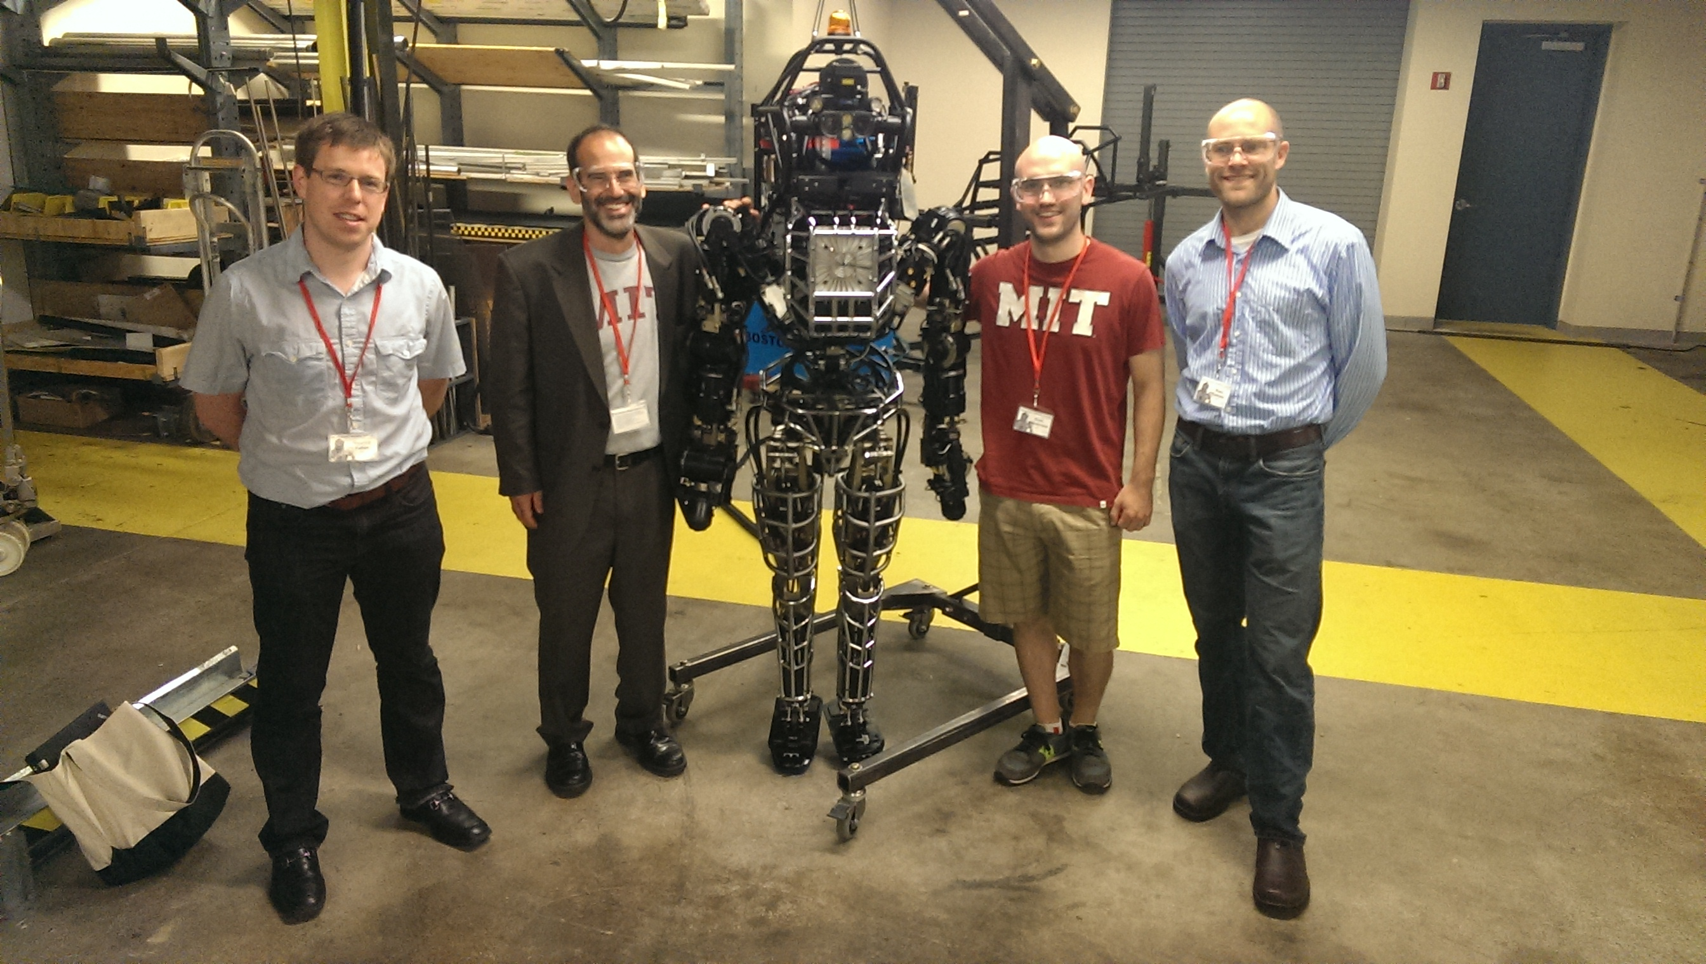
Bio-Imaging
Surveillance
Medical Imaging
Autonomous Cars
Mapping
Robotics
Social Media

Slide 13
Overview of the field
Conferences
Computer Vision
Computer Vision and Pattern Recognition (CVPR)
International Conference on Computer Vision (ICCV)
European Conference on Computer Vision (ECCV)
British Machine Vision Conference (BMVC)
Machine learning
Neural Information Processing Systems (NIPS)
International Conference on Machine Learning (ICML)
International Conference on Learning Representations (ICLR)

Slide 14
Overview of the field
1. | Advanced Materials | 252 | 342
2. | IEEE/CVF Conference on Computer Vision and Pattern Recognition | 240 | 383
3. | Energy & Environmental Science | 207 | 323
4. | ACS Nano | 203 | 280
5. | Nano Letters | 188 | 270
6. | Nature Materials | 179 | 323
7. | Renewable and Sustainable Energy Reviews | 174 | 238
8. | Neural Information Processing Systems (NIPS) | 169 | 334
9. | Journal of Materials Chemistry. A | 163 | 214
10. | Nature Nanotechnology | 160 | 278
11. | Advanced Functional Materials | 154 | 203
12. | Advanced Energy Materials | 152 | 211
13. | International Conference on Learning Representations | 150 | 276
14. | Nature Photonics | 150 | 261
15. | ACS Applied Materials & Interfaces | 147 | 188
16. | Chemistry of Materials | 141 | 191
17. | Nanoscale | 139 | 188
18. | European Conference on Computer Vision | 137 | 263
19. | International Conference on Machine Learning (ICML) | 135 | 254
20. | Journal of Cleaner Production | 132 | 166
Google scholar, Engineering & Computer Science (as of Oct. 19)

Slide 15
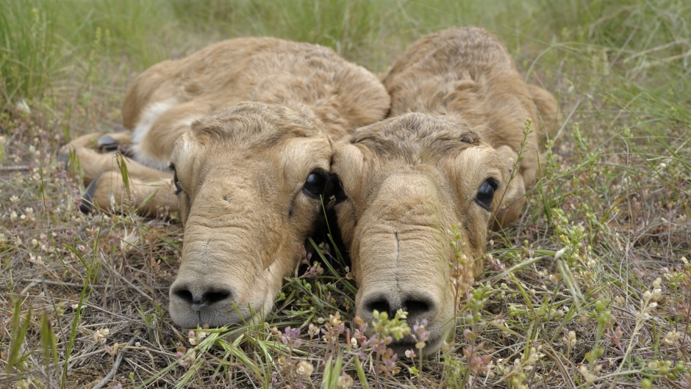
Typical vision problems
Recognition
“Saiga antilope”
Task: Label an image by its class membership

Slide 16
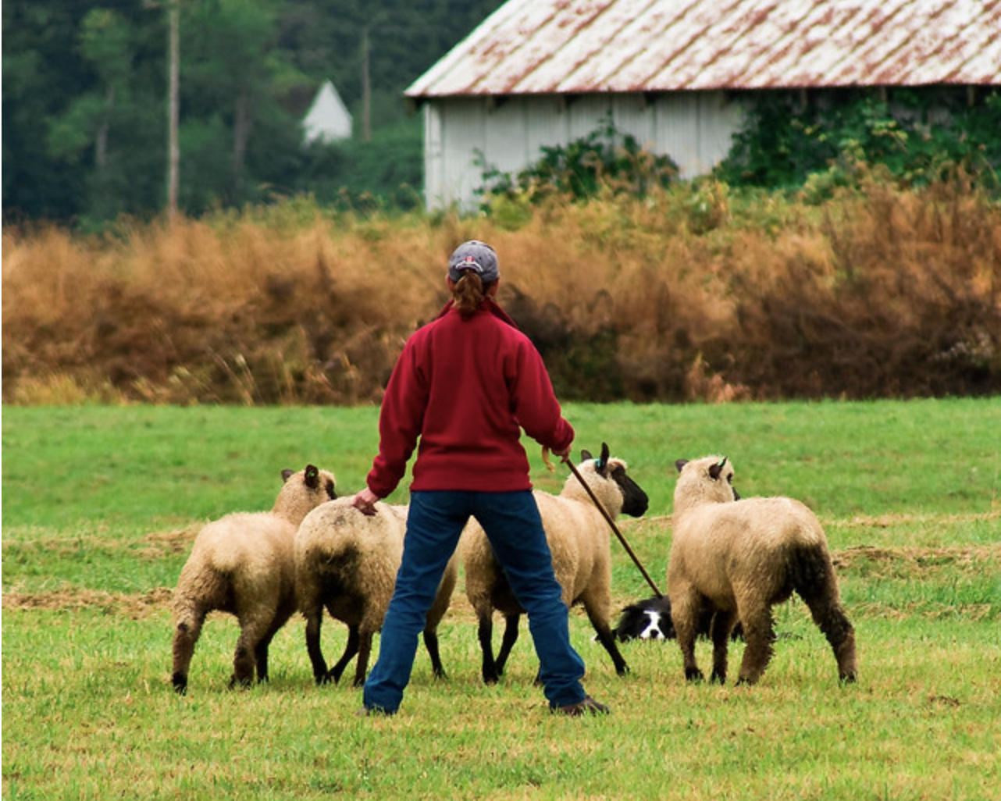

Typical vision problems
Segmentation
Task: Label each pixel of an image by its class memerbership.

Slide 17
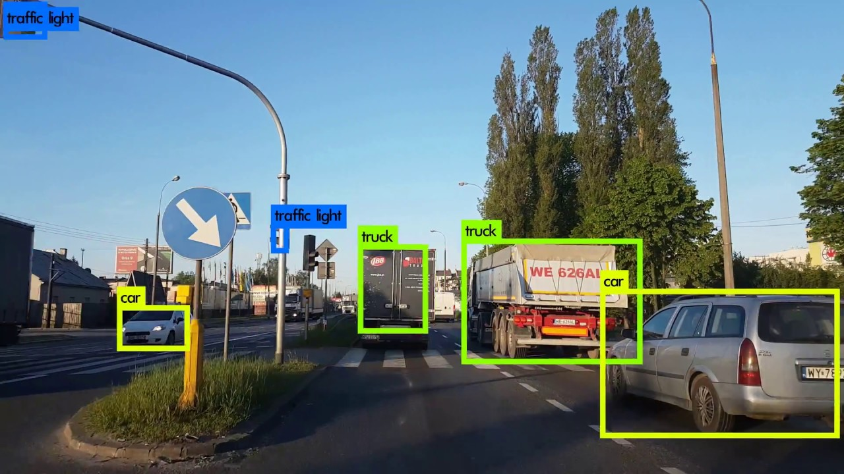
Typical vision problems
Detection
Task: Locate and label objects via, e.g., bounding boxes

Slide 18
Typical vision problems
Image-to-Image translation
Label map → Image
Arial → Map
BW → Color

Slide 19
Some interesting resources
Browse D. H. Hubel’s online book (Nobel prize winner, 1981)
http://hubel.med.harvard.edu/book/bcontex.htm
Read one of his and Torsten Wiesel’s seminal papers, e.g.,
Receptive Fields and Functional Architecture of Monkey Striate Cortex,
D. H. Hubel and T. N. Wiesel
J. Physiol., 1968
http://www.ncbi.nlm.nih.gov/pubmed/4966457)

